Slide 1

State-of-the-Art Open-Source GenAI: Leveling the Playing Field for Every Business
Insights on how the democratization of AI is creating unprecedented opportunities for businesses of all sizes
Presented by Dr. Karl K. Zhao, Ph.D.

Slide 2

About Dr. Karl K. Zhao, Ph.D.
Dr. Karl K. Zhao is a distinguished AI leader with over 15 years of expertise in generative AI, robotics, and cloud platforms. He is renowned for leading large engineering teams and scaling businesses to significant revenue.
Notably, he developed RobotGPT, the first multimodal LLM for robotics. Currently, as a GenAI Consultant at DeepSeek AI and Gabe IO, Dr. Zhao empowers businesses with cutting-edge open-source AI strategies.
He holds a Ph.D. from Northeastern University and a B.S. from Tsinghua University.

Slide 3

A Paradigm Shift in GenAI Access
For years, generative AI has been:
Dominated by closed ecosystems
Controlled by big tech companies
Prohibitively expensive for most
Inaccessible to smaller businesses
Until now. We've entered a new era where State-of-the-Art Open-Source (SotaOS) GenAI is democratizing access and creating a rare strategic opportunity.

Slide 4

Why This Moment Matters
Early Adoption Advantage
Narrowing Competitive Gap
We're in a unique window where smaller companies can implement advanced AI capabilities before they become table stakes.
Open-source AI tools provide enterprise-grade capabilities without enterprise-level budgets, leveling the competitive landscape.
First-Mover Opportunity
Organizations that integrate SotaOS GenAI now will define industry standards and expectations for the next decade.

Slide 5
The Evolution of GenAI Accessibility
2020-2021: Limited Access
2023: Enterprise Adoption
Closed ecosystems like GPT-3 available only to select partners and major enterprises through restrictive APIs.
Large companies begin implementing proprietary GenAI solutions with significant investment in infrastructure and expertise.
1
2
3
4
2024: Democratization
2022: Consumer Applications
ChatGPT and similar tools bring GenAI to consumers, but business applications remain limited by cost and customization barriers.
State-of-the-art open-source models match or exceed proprietary options, enabling businesses of all sizes to compete.
We are here — at the inflection point where open-source GenAI is becoming powerful enough to transform businesses across industries.

Slide 6

What Makes SotaOS GenAI Different?
Transparency
Full visibility into model architecture, training data, and limitations enables responsible implementation and customization.
Customizability
Models can be fine-tuned for specific industry needs without paying per-token or per-call fees to third parties.
Cost-Effectiveness
Elimination of usage-based pricing models dramatically reduces operational costs for high-volume AI applications.
Data Privacy
On-premises deployment ensures sensitive business data never leaves your infrastructure or trains competitors' models.

Slide 7

The Business Impact: David vs. Goliath
SotaOS GenAI is creating a rare opportunity where smaller, more agile companies can compete with established industry giants.
60%
85%
3-5x
Cost Reduction
Customization
Implementation Speed
Average reduction in operational costs compared to proprietary GenAI solutions for similar capabilities.
Percentage of businesses reporting better results with tailored open-source models vs. generic proprietary solutions.
Faster deployment timeframes for businesses using open-source GenAI compared to building custom closed solutions.

Slide 8
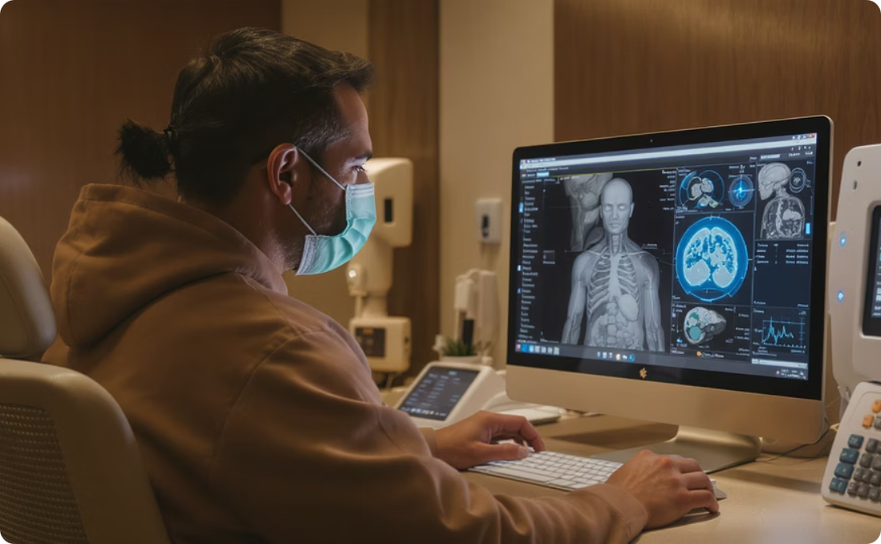
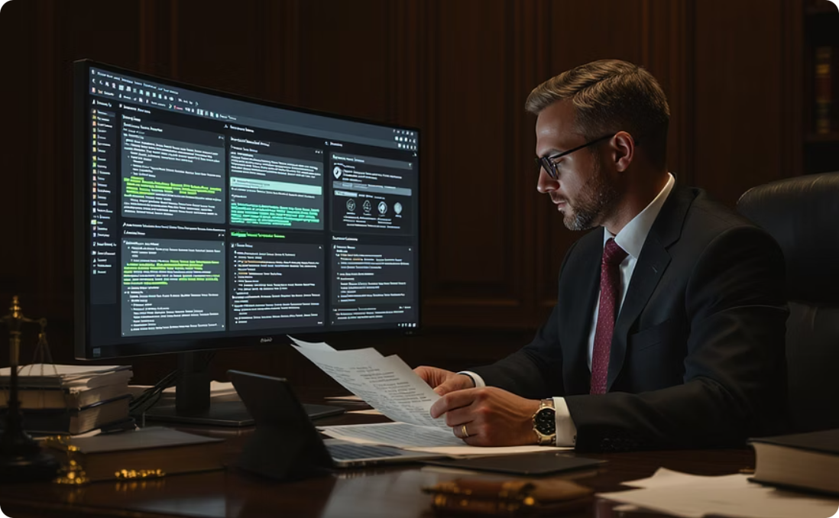
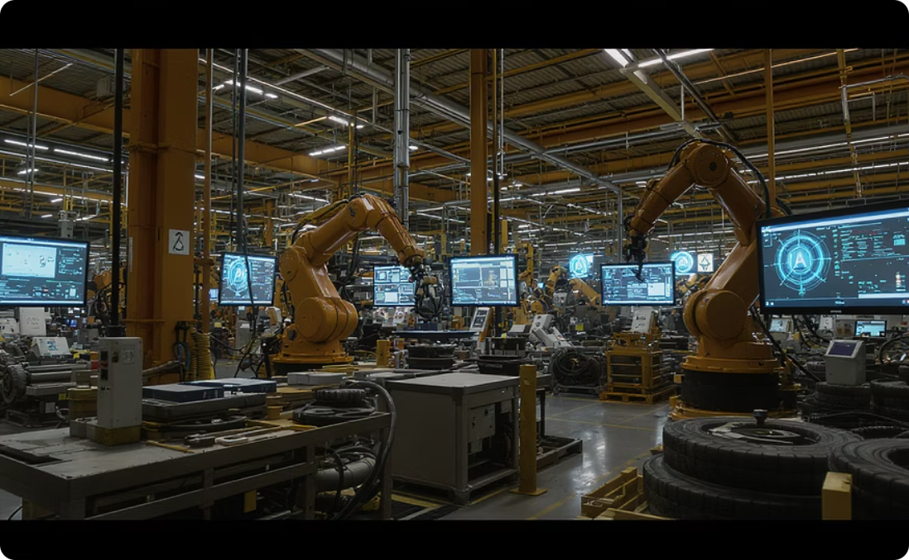
Real-World Applications Across Industries
Healthcare
Legal
Manufacturing
Medical image analysis, patient triage, personalized treatment recommendations, and research acceleration without sharing sensitive patient data.
Contract analysis, legal research automation, precedent identification, and document review with complete confidentiality protection.
Predictive maintenance, quality control automation, supply chain optimization, and design innovation using proprietary process data.
Each of these implementations leverages the unique advantages of open-source GenAI: customization, data privacy, and cost-effectiveness.

Slide 9
The Cost of Waiting
The AI Gap Is Widening
78%
Early Adopter Advantage
Percentage of businesses reporting significant competitive advantages from early GenAI implementation.
42%
Market Share Growth
Companies implementing SotaOS GenAI today are creating an expanding competitive advantage that becomes increasingly difficult to overcome.
Average increase in market share reported by companies that implemented GenAI solutions before competitors.
"The companies that adopt SotaOS GenAI now will define the next decade in their industries. If you wait too long, the gap will be too wide to catch up."
18%
Late Adopter Decline
Average market share loss for companies that delayed GenAI adoption more than two years after competitors.

Slide 10

Implementation Roadmap: Your Path Forward
Assessment & Discovery
Model Selection & Customization
Identify high-value use cases specific to your business and industry. Evaluate data readiness and infrastructure requirements.
Choose appropriate open-source models based on specific needs. Implement fine-tuning strategies using your domain-specific data.
Pilot Implementation
Scaled Deployment & Integration
Deploy in controlled environments with clear success metrics. Gather feedback and iterate based on real-world performance.
Expand successful pilots across business units. Integrate with existing workflows and systems for maximum impact.
The typical timeline from assessment to initial value realization is 8-12 weeks for most mid-sized businesses—significantly faster than traditional AI implementations.

Slide 11

Key Takeaways
The Window of Opportunity Is Now
Open-Source = Accessible Power
Early Adoption = Lasting Advantage
We're in a rare moment where smaller companies can leapfrog larger competitors through strategic AI adoption.
SotaOS GenAI provides enterprise-grade capabilities without enterprise-level budgets or restrictions.
The companies implementing these technologies today are building insurmountable advantages for the next decade.
Contact Dr. Karl K. Zhao at karl@gabeio.com to discuss how your business can leverage SotaOS GenAI for competitive advantage.

